Slide 1
Prescriptive analytics

Slide 2
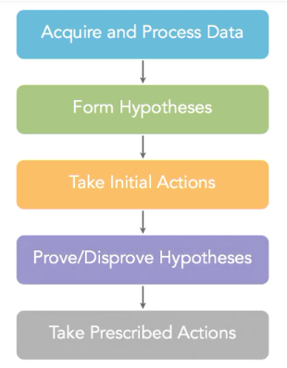
Prescriptive analytics workflow
Many organizations are investing in analytics as they understand the importance of driving decisions and actions based on actionable insights from real time data rather than just experience and intuition.
The data from various sources is needed to formulate hypotheses. And initial course of action is drafted, based on the analytical models which can either prove the formulated hypothesis to be true or not , corrective actions are taken, if required.

Slide 3
Types of data
Structured(relational database & filesystems)
Semi-Structured(emails , tweets, forms)
Unstructured(images, audio, video)
Our analytical capabilities need to produce insights from different paradigms. Other insights come from turning our analytical models loose on incredibly large volumes of data, and then looking for hidden patterns and causal relationships and things that we may not necessarily ever have thought about. But the power of our technology ferrets out those things and shows them to us and lets us take action upon them.

Slide 4
Analytics taxonomy: what types of questions do they answer
Descriptive analytics: What happened and why as well as what’s happening right now and why
Predictive analytics: What is likely to happen and why
Discovery analytics: Looking into something interesting in the lines of the data available to us. Trying to figure out if there is probable discovery of interesting patterns and correlations
Prescriptive analytics: The output of the above three categories of analytics is fed to the prescriptive analytics engine, and it guides us by not only what is going on but also what needs to be done about them.
All four needs to work together in continuum to reap the greatest business benefits.

Slide 5
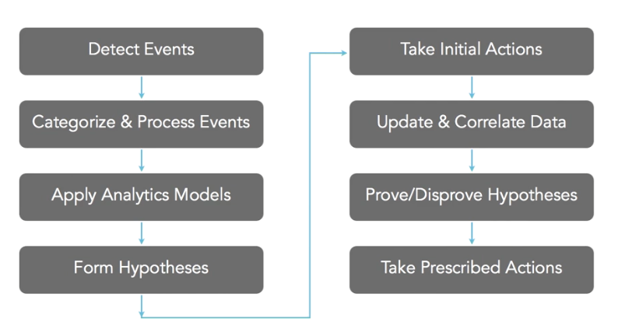
Prescriptive analytics : building blocks
Workflow begins by detection of events. Events are categorized, processed and data is derived from them to be used for analytical models. Result of these hypothetical model would lead to formulation of hypothesis As we form hypotheses, it's very important that nothing falls through the cracks and we will have a list of initial actions we'll take along every one of our prescriptive analytics workflows that are appropriate for that particular scenario. Finally, the prescriptive analytics stands through the fact that once the hypothesis are proven or disproven, the actions are taken.

Slide 6
Identifying events
The events could be triggered by the possible triggers like a new chunk of data, signal or a business event. Complicated business events could be a raising prices of raw materials, new regulations for procurement of raw materials, ore let say the competitors launching a new product line.
Events could also be discrete or synthesized. Synthesized events could be looking at pressure readings from sensors deep down in natural gas exploration wells and if the pressure readings are above a certain point that could indicate a potential problem that we need to explore.
Data driven events sometimes are Boolean. An output code like true or false could be a possible output.

Slide 7
Formulating
Prescriptive analytics = analytics + business workflow
Prescriptive analytics combines the event driven and analytics driven actions.
Event-Driven Actions: the event itself forms the initial hypothesis.
This is the staring point and then we can finetune the system and workflow.
On detecting the event, first validate the data . Decisions need not be formulated on bad data, Then take the initial prescribed actions, keeping in mind to avoid “point-of-no-return” actions. Ensure then that the analytics are triggered, Finally vigilantly monitor the hypothesis.

Slide 8
Analytics and data
We might have all the data necessary for the analytics ir we might need some additional data subjects and attributes needed to prove or disprove hypothesis. Then we need to identify the correlation, is there a pre determined correlation which is narrowly defined by the business questions, or a dynamic correlation which is tracking unplanned findings.
Managing high velocity hypothesis: Even analytics that aren't high-velocity in nature, still need to be handled proactively and as rapidly as possible to be effective, but in general they do tend to have less complex workflows, typically a single pass from the point at which we capture data all the way through to when we take their prescribed actions. In these cases, fast may be a matter of hours or days or even longer for many strategic type of analytics. High velocity analytics, though, often involve multiple passes through our workflow with processes looping back to some previous point as new data is acquired and processed.

Slide 9
Definitive conclusion
Business hypotheses are a fundamental concept of prescriptive analytics because they allow us to go beyond our traditional limitations of only acting on a factual basis. Now, we can use the power of our analytics to indicate to us what's likely to happen or some interesting and potentially important pattern for our organization that has been figured outby our discovery analytical models. What's particularly important about this workflow is that these hypotheses aren't just wild guesses, but rather, they're the result of a progressively refined and broadened portfolio of analytical models and the portfolio is closely aligned with the most important decisions and actions of your organization.
Sometimes, we'll analyze and evaluate totally different information and the synergistic effect of that information, with the data we already have, helps us either prove or disprove the hypothesis and sometimes, especially in timer-based situations, we never quite get to the pointof definitively proving a hypothesis, but we need to make a default decision because the consequences of not acting at all are just too severe. Let's go back to several of the examples we've seen earlier and take each of their hypotheses farther down the prescriptive analytics workflow to the point of which we either prove or disprove each one's hypothesis.

